Slide 1
Chasing down the neural code
with mathematics and modeling
Eric Shea-Brown
2
Notes:
4/09 – ABOUT 27 MINS
!!!!!!!!!!!!!!!!!!!!!!!!!!!!!!!!!!!!!!!!!!!!!!READ NOTES PAGES!!!!!!!!!!!!!!!!!!!!!!!!!!!!!!!!!!!!!!!!!!!!!!!!!!!!!!1
OVERALL remark, 12/03 BWF – make sure are clear about own contribs!
Thesis talk – In my thesis I show…
With emphasis on NEW remarks in NOTES pages … ESPECIALLY FACT THAT it is worth looking for our mechanism
for phasic tonic transition because … once figure out what mechanism is, can look for brain areas equipped to carry out that
mechanism. In our case this mech is just decreased baseline inputs. WELL we just saw that prefrontal areas are afferent to
LC … with excitatory and, due to recent GAJ data, also inhibitory inputs. So, due to the discovery that baseline rate matters, this makes
prefontal areas candidates for directly influencing LC mode. V. interesting in context of cognitive control. Perhaps should make a slide on this.
OTHER thing to emph is role of TONIC mode – so LC mode is “so great” at the task, why would you ever want to be tonic? Maybe also good for a slide.
cognitive control: changes in behavoiur to adapt to changing circumstances
SIAM: 25 mins
FROM SPIKES TO SPEED-ACCURACY VIA THE BRAINSTEM Recent brain recordings suggest a link between different firing patterns in the brainstem nucleus locus coeruleus (LC) and different levels of performance in simple cognitive tasks. I will describe mathematical models for these firing patterns, based on phase reduction and a probability density formulation. Then, in an extension of previous work, I will discuss a possible role for the LC in optimizing speed and accuracy in decision tasks, via release of neuromodulators which dynamically adjust the sensitivity (i.e. gain) of neural populations. This joint work with Jeff Moehlis, Phil Holmes, Mark Gilzenrat, and Jonathan Cohen.

Slide 2
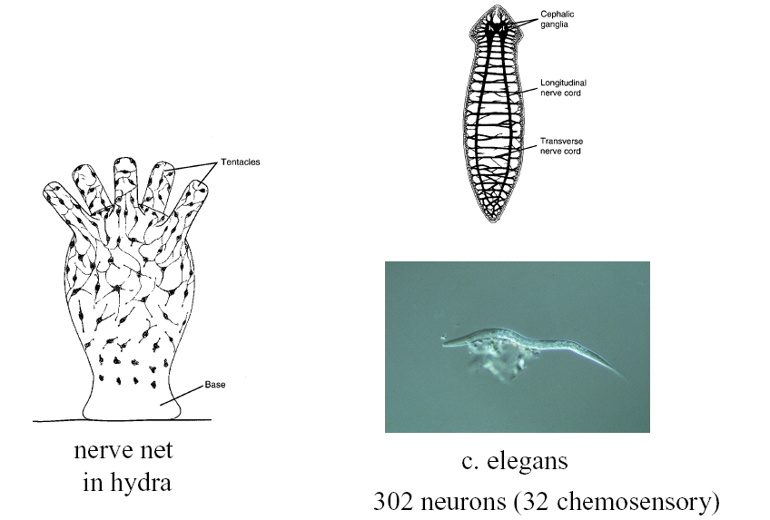
Invertebrates – nerve nets and ganglia
(thanks to David Tank)
Cephalic ganglia
Nerve cords
5
Notes:
C elegans is nematode

Slide 3
Us
10¹¹ neurons
(10⁵ per mm³)
10¹⁵ synapses
6

Slide 4
Electrical signals come IN to dendrites, are “integrated” in cell body, result goes OUT axon
motor neuron (spinal cord)
mitral cell
(olfactory bulb)
dendrite
Pyramidal cell
(cortex)
cell body
axon
Purkinje cell (cerebellum)
From Nicholls et al, 1992, Fisher and Boycott, 1974, Johnston and Wu, 1997

Slide 5
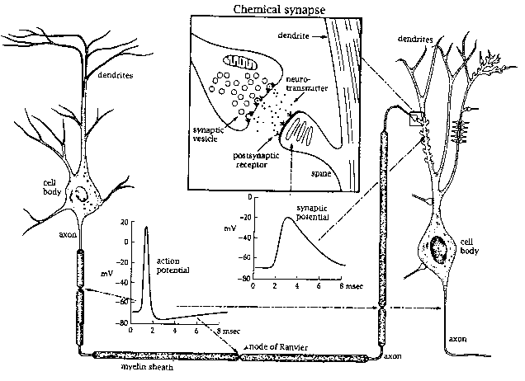
Given sufficient input, neurons “fire SPIKES”
INPUT
DENDRITES
CELL BODY
Action potential
~100 mV
OUTPUT
AXON
0 10 msec
Johnston and Wu, 1997
7

Slide 6
Given sufficient input, neurons “fire SPIKES”
… communicated downstream
INPUT
CHEMICAL SYNAPSE
CELL BODY
mV
OUTPUT
0 10 msec
AXON
0 10 msec
Johnston and Wu, 1997
8

Slide 8
whydomath.org

Slide 9
The secret ingredient: differential equations!

Slide 10
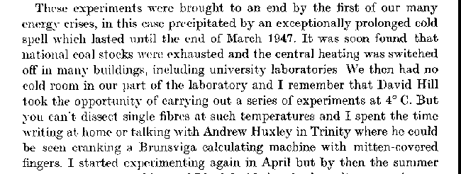
Hodgkin and Huxley’s equations ...
dv(t)/dt=(I - gna*h*(v-vna)*m^3-gk*(v-vk)*n^4-gl*(v-vl))/c
dm(t)/dt= am(v)*(1-m)-bm(v)*m
dh(t)/dt=ah(v)*(1-h)-bh(v)*h
dn(t)/dt=an(v)*(1-n)-bn(v)*n
am(v) = .1*(v+40)/(1-exp(-(v+40)/10))
bm(v) = 4*exp(-(v+65)/18)
ah(v) = .07*exp(-(v+65)/20)
bh(v) = 1/(1+exp(-(v+35)/10))
an(v) = .01*(v+55)/(1-exp(-(v+55)/10))
bn(v) = .125*exp(-(v+65)/80)
+ σπατιαλ “διφφυσιον” τερμσ
Then: using a Brunsviga 20 manually cranked calculator with numbers entered by a set of adjusting levers (projecting from the wheels that were rotated by the hand crank). The output was a line of digits on the wheels to be read and transcribed to paper.
hh.m
Now:

Slide 11
50
V(mV)
-50
0
t (ms)
50
9

Slide 12
Given spikes … Where's the information?

Slide 13
Given spikes … Where's the information?
1. Averaged spike statistics
12

Slide 14
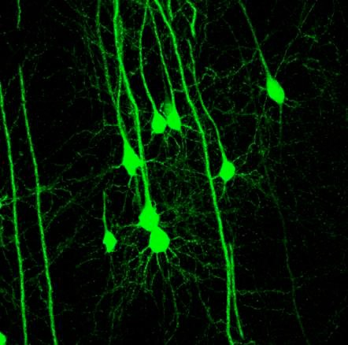
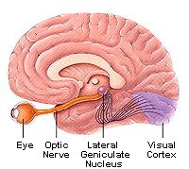
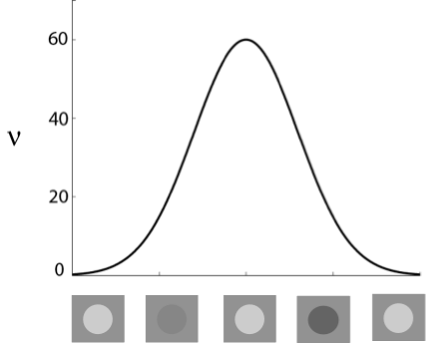
Cortical encoding via spiking rates
Hubel and Weisel. J. Physiol.,1962
Reddy, Kreiman, Koch, and Fried (2005)
Notes:
Start with perhaps the most classical example of information being carried in statistics, that of hubel and wiesel, more than 40 years ago.
Here see, for diff. orientations, diff rates elicited … in this sense, rates carry info about the stimulus identity

Slide 15
Given spikes … Where's the information?
1. Averaged spike statistics
vs.
Frequency, …
14

Slide 16
Given spikes … Where's the information?
1. Averaged spike statistics
vs.
Frequency, …
2. Precise spike timing
vs.
Spike times {t_{j}}
15
Notes:
Say – when think about stats, think about frequency, but info can also be carried in higher order stats like regularity of ISIs and corrs
Examples of info being carried primarily on both of these spatial (avg over many neurons) and temporal (avg over window to get stats) scales in neurobio.
Today, describe how we're using math modeling to describe aspects of these different types of signal encoding.
(Note – of course have continuum … today will consider to 'extreme points' in range of scales …)
My goal is to use tools from stat mech, probability, and dynamical systems to address fundamental questions about information transmission in the brain at both of these levels and scales…

Slide 17
Given spikes … Where's the information?
1. Averaged spike statistics
vs.
Frequency, …
2. Precise spike timing
vs.
Spike times {t_{j}}
Biology: BOTH.
Metrics: Fisher Information, Mutual Information …
16
Notes:
Might wonder whether info is also carried on finer scales, and it is:

Slide 18
Neural coding in general!
stimulus
s
...

Slide 19
Multielectrode recordings
Shlens et al ’09
Notes:
Here is an example of the of kind of populations I am thinking about.
This movie was constructed from recordings of primate retinal ganglion cells.
(The output cells of the retina).
Each oval represents one cell; the shape is
an approximation of the spatial extent of the cell's receptive field. The spike times
during this recording are indicated by the cell flashing red. We can see large,
synchronous, spatially contiguous clusters.
(These are not obviously stimulus driven; during this recording, the retina was
stimulated by a randomly flickering checkerboard pattern, but the checkers were
small relative to the receptive fields.)

Slide 20
Neural coding in general!
stimulus
s
...
Shlens et al ’09

Slide 21
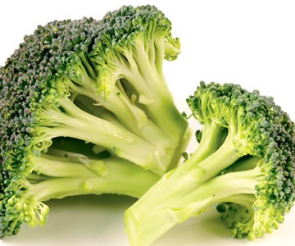
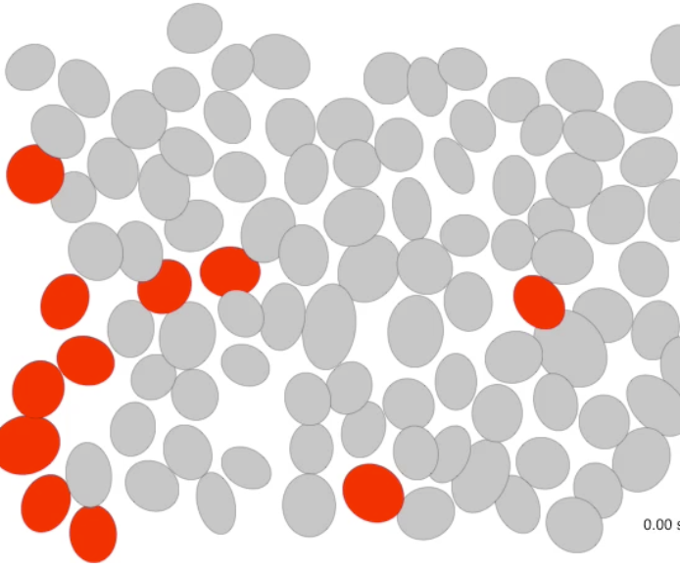
Neural coding
encoding
decoding
correct!
s(t)
Guillaume
Lajoie

Slide 22
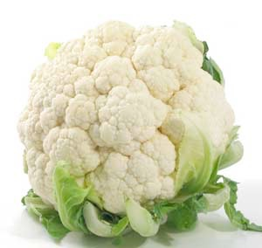
Neural coding
encoding
decoding
error!
s(t)

Slide 23
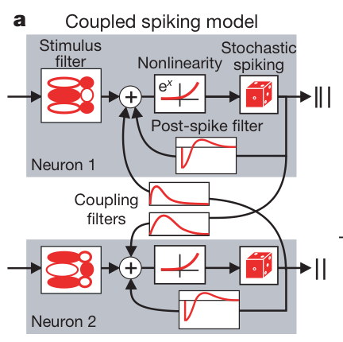
Neural coding
encoding
decoding
error!
s(t)

Slide 24
Scientific computing + numerical analysis
Dynamical systems
Statistics and Probability (stochastic processes)

Slide 25
whydomath.org
... click on spinning brain
compneuro.washington.edu
or
faculty.washington.edu/etsb

